Slide 1
Employee Data Analysis using Excel
STUDENT NAME: SWETHA E
REGISTER NO: 312209154
NAAN MUDHALVAN ID: 426FD439DB014C6A3B2474D6BD6DF305
DEPARTMENT: COMMERCE
COLLEGE: ANNA ADARSH COLLEGE FOR WOMEN

Slide 2
PROJECT TITLE
Employee salary and compensation Analysis using Excel

Slide 3


AGENDA
Problem Statement
Project Overview
End Users
Our Solution and Proposition
Dataset Description
Modelling Approach
Results and Discussion
Conclusion
3/21/2024 Annual Review

Slide 4

PROBLEM STATEMENT
The problem is to analyse employee salaries to identify patterns and discrepancies related to factors like job role, experience, education, and gender. The goal is to ensure fair compensation, equity, and compliance with equal pay standards.

Slide 5

PROJECT OVERVIEW
The project overview for employee salary analysis involves examining salary data to understand compensation patterns, identity disparities, and ensure pay equity. It includes data collection, statistical analysis, and comparison against benchmarks. The findings are presented in reports and visualizations to guide decision-making and policy adjustments.

Slide 6
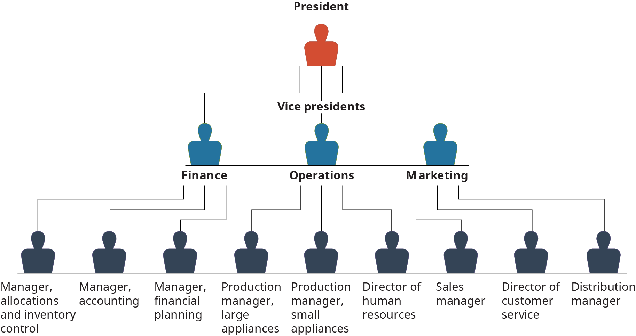

WHO ARE THE END USERS?

Slide 7

OUR SOLUTION AND ITS VALUE PROPOSITION
Conditional Formatting – Missing
Filter – To Remove the blanks
Pivot Table – Summary
Graph – Data visualization

Slide 8
Dataset Description
Employee Dataset –kaggle
8 features
Employee ID – Number
Name – Text
Gender – Text
Department – Text
Salary – Number
Start date – Number
FTE – Number
Employee type – Text
Work location - Text

Slide 9

THE "WOW" IN OUR SOLUTION
Advanced formula
Advanced techniques
3/21/2024 Annual Review
9

Slide 10
MODELLING
DATA COLLECTON
Employee data set collected from kaggle
Download the employee dataset using email id
FEATURE COLLECTION
Open the employee dataset using excel
There are many details of employee dataset which has been given
Select the feature which ever is needed for our topic
DATA CLEANING
Using conditional formatting to find out the missing values in using colour. This technique I was used in salary details .
Conditional formatting – click conditional formatting then go to highlight cells rules and go to more rules it shows format only cells that contains with , select the option blanks and click format , then go to fill colour, then click ok.
Then colours are filled in missing value.
.
10

Slide 11
To remove the blanks, so the click sort and filter and go to filter option then click filter by colour and select no fill. Therefore, our salary details are filtered.
SUMMARY
Create a pivot table for summarizing our data which was selected in employee dataset
Then, select the details which is needed for our topic and separate the detail under the head of filter, rows, columns and values. In rows, I was selected the employee id and name of the employee. In columns, I was selected the department. For values, I was select the salary. For filter, I was selected gender, start time and employee type.
Simultaneously, one by one summarized pivot table will create.
VISUALISATION
Click all select on the pivot table and go to insert and click recommended chart
Then, Click columns and select a graph
Graph has been created
Graph shows on the display of the excel and take a copy of graph to paste in the ppt under the head of result.

Slide 12
RESULTS
12

Slide 13
conclusion
Based on the salary analysis, it is concluded that while the company offers competitive salaries in certain departments, there are noticeable disparities in others, particularly in roles that require niche skills. The salary analysis reveals that one department receives significantly higher salaries compared to other departments. Which may indicate a need for salary adjustment in other departments. Implementing a structured salary review process could help improve equity and retention.

